Slide 1
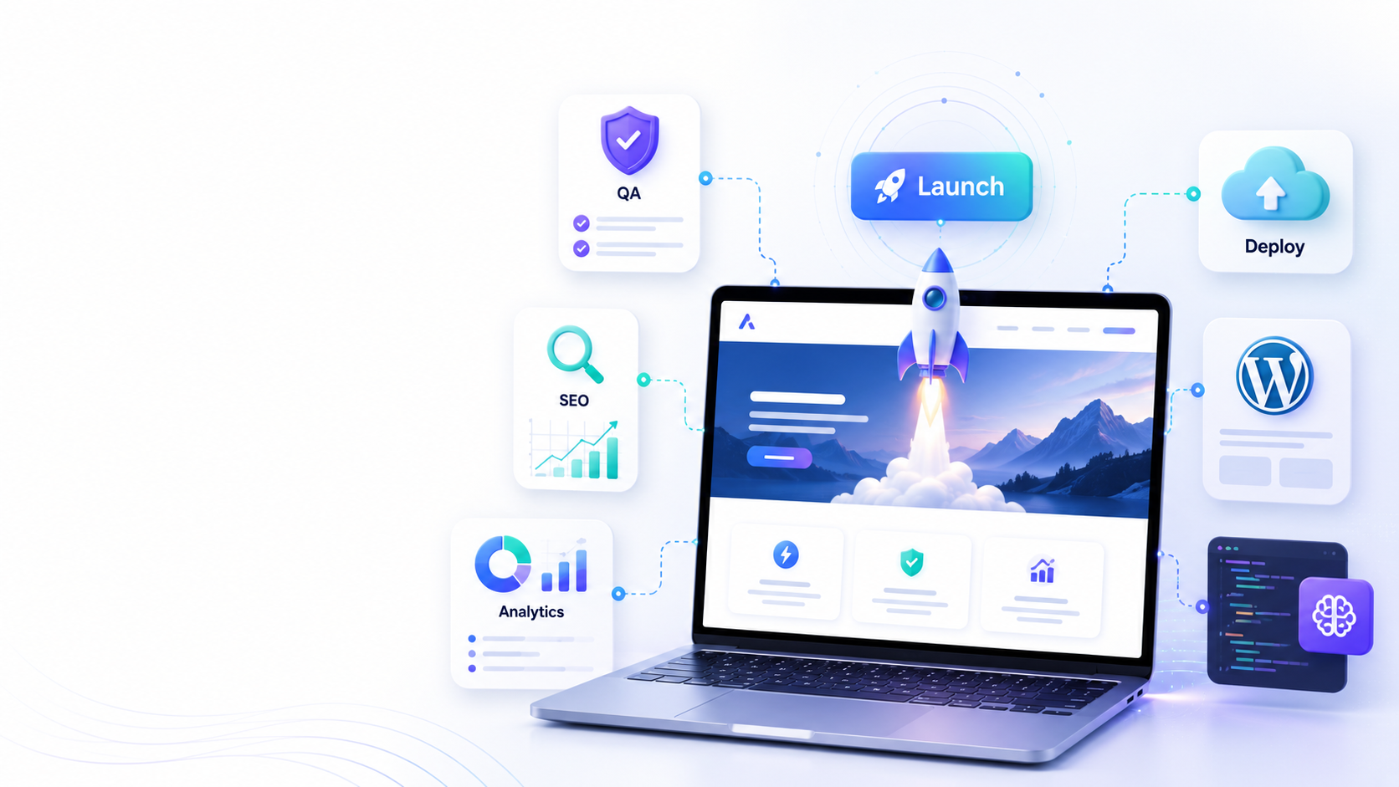
WEEK 5–6
Final Build, Testing & Launch
Participants move from a working prototype to a publishable website: content, admin, QA, deployment, SEO, analytics, and final presentation.
2 weeks combined
Launch-ready project
Final demo
Goal
✓
Make the website functional
✓
Prepare real content and forms
✓
Publish or prepare deployment
✓
Present the final web solution
Web Creation Program • Week 5–6

Slide 2
Week 5 — Content Integration & Functional Website
From design to a working site with real sections, content, forms, and admin logic.
01
1. Build real pages
02
2. Insert final content
03
3. Add interaction
Home
About / Services
Contact / Register
Portfolio or product pages
Logo and identity
Images and videos
Texts and call-to-action
Social links
Navigation menu
Buttons and links
Forms
WhatsApp or email action
04
4. Admin / CMS option
05
5. Responsive polish
06
6. Save versions
Admin login
Create / edit content
Manage products or posts
Simple dashboard
Mobile version
Tablet version
Spacing and readability
Image optimization
Backup files
Document prompts
Keep assets organized
Export working code
End of Week 5 output: a working website prototype with real content and basic functionality.
Web Creation Program • Week 5–6

Slide 3
Week 5 Task Board
Suggested daily rhythm for participants.
Day 1
Day 2
Day 3
Day 4
Day 5
Collect assets
Build pages
Add forms
Admin / CMS
Mobile QA
Logo, colors, text, images, product/service info
Create all main website sections and navigation
Contact, registration, WhatsApp, email or inquiry flow
Choose Antigravity backend or WordPress workflow
Fix layout, speed, links, image sizes, and buttons
📁
🧱
📝
⚙
📱
Coach note: every participant should explain what they changed and why, not only show the result.
Web Creation Program • Week 5–6

Slide 4
Week 6 — Testing, SEO, Deployment & Final Presentation
Turn the prototype into a professional project ready to share.
✓
Test every menu link and button
✓
Check forms, messages, and confirmations
✓
Add titles, descriptions, keywords and basic SEO
✓
Connect analytics or prepare KPI tracking
✓
Publish, export, or document deployment steps
✓
Prepare a 5-minute final demo
Final target: participants can show a real web solution and explain their AI workflow from idea → prompt → design → build → launch.
Web Creation Program • Week 5–6

Slide 5
Launch Checklist
The checklist participants complete before final validation.
🎨
UX & Design
✍
Content
Readable text
Clear call-to-action
Consistent colors
Mobile friendly
Real services/products
Correct contact info
Strong hero section
No empty placeholders
🛠
Technical
📈
SEO & Tracking
Forms work
Links work
Fast loading
No console errors
Page title
Meta description
Keywords
Analytics / report
Validation rule: if one item is missing, the participant fixes it before the final presentation.
Web Creation Program • Week 5–6

Slide 6
Two Build Options for Final Delivery
Each participant chooses one clear path and documents the workflow.
Option A
Option B
Google AI Studio + Antigravity
WordPress Solution
✓
Generate frontend from Figma/prompt
✓
Build pages with a theme or blocks
✓
Create backend/admin logic
✓
Add forms, posts, products or services
✓
Connect forms and database needs
✓
Install essential plugins only
✓
Export or deploy the working project
✓
Publish with domain and hosting
Web Creation Program • Week 5–6

Slide 7
Final Participant Presentation
A simple structure for the final 5-minute demo.
1
2
3
4
5
Problem
Identity
Website
System
Marketing
What business need are you solving?
Show logo, colors, tone, audience.
Walk through pages and actions.
Explain admin, forms, backend or CMS.
Show SEO, social plan and next steps.
Deliverables: final website link or exported file + prompt history + identity board + launch checklist + short marketing plan.
Web Creation Program • Week 5–6

Slide 8
Week 5–6 Outcome
Each participant finishes with a complete digital project, not only a design.
✓
A branded website
✓
Working buttons/forms
✓
Admin or CMS logic
✓
Basic SEO setup
✓
Launch checklist
✓
Final demo
Ready to present
Ready to improve
Ready to publish
Web Creation Program • Week 5–6

