Slide 1
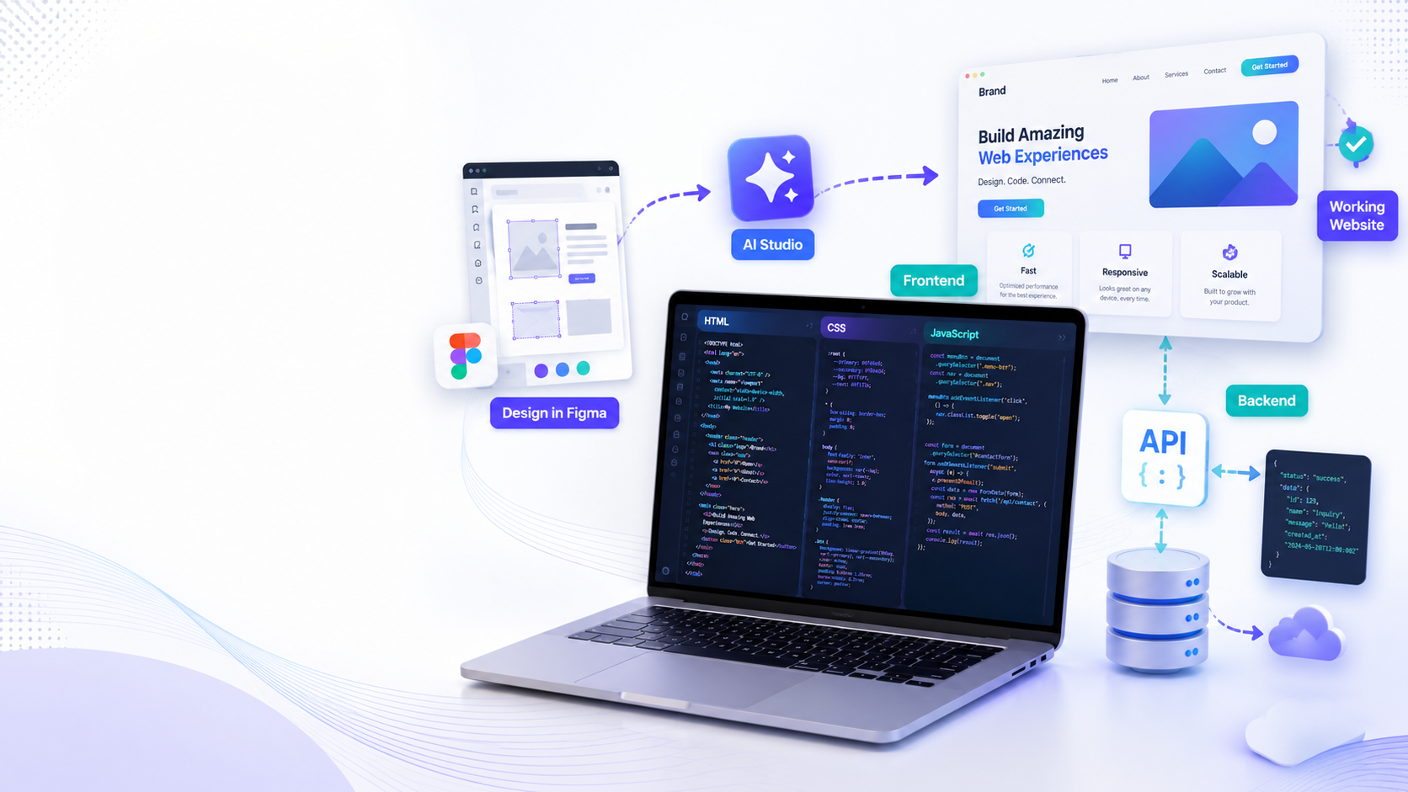
Week 3
Google AI Studio Build
Frontend + backend foundation for the participant website project.
FROM FIGMA TO WORKING PROTOTYPE
Participants transform Week 2 designs into a functional single-page web experience, then connect the first data logic.
AI workflow: design → frontend → backend → publishable prototype

Slide 2
WEB CREATION PROGRAM
Week 3
Learning goals
By the end of Week 3, each participant should have a first working prototype.
✦
Understand the role of Google AI Studio in building web interfaces from clear prompts.
</>
Generate and improve frontend code: HTML, CSS, JavaScript, responsive layout.
API
Add simple backend logic: form data, local storage, JSON structure, admin flow idea.
✓
Test, repair, document, and prepare the prototype for Week 4 integration.
Output: a clickable website prototype with clean structure
AI workflow: design → frontend → backend → publishable prototype

Slide 3
WEB CREATION PROGRAM
Week 3
Week 3 workflow
A practical build pipeline from design to a working website.
1
2
3
4
5
Prepare
Generate
Customize
Connect
Test
Collect Figma screen + brand rules
Prompt AI Studio for one HTML file
Adjust sections, buttons, responsive UI
Add forms + saved data logic
Fix bugs and present prototype
Build mindset: prompt → preview → inspect → repair → document
AI workflow: design → frontend → backend → publishable prototype

Slide 4
WEB CREATION PROGRAM
Week 3
Participant weekly task plan
Each day produces a concrete piece of the final prototype.
D1
Import the design direction
D2
Frontend generation
D3
UI refinement
Use the Week 2 Figma/Stitch output and define the site sections.
Prompt Google AI Studio to create one HTML/CSS/JS prototype.
Improve spacing, colors, typography, mobile behavior, and CTAs.
D4
Backend logic basics
D5
Test and repair
D6
Mini presentation
Add contact form, JSON object, local storage, and first admin idea.
Check buttons, forms, navigation, responsiveness, and broken content.
Show the website, explain AI prompts, list fixes for next week.
Teacher checkpoint: each participant submits the HTML file, screenshots, and a short prompt history.
AI workflow: design → frontend → backend → publishable prototype

Slide 5
WEB CREATION PROGRAM
Week 3
Frontend build checklist
The website must feel real, clear, and ready to demonstrate.
✓
Hero section
logo, headline, CTA, background
✓
Core blocks
about, services/products, gallery, contact
✓
Responsive design
desktop + mobile layout
✓
Interaction
menus, buttons, scrolling, form feedback
✓
Clean code
one HTML file, readable sections, comments
Rule for Week 3: no empty template. Every section must contain real brand content from the database.
AI workflow: design → frontend → backend → publishable prototype

Slide 6
WEB CREATION PROGRAM
Week 3
Backend foundation + deliverables
Week 3 does not need a complex app — it needs a clear data logic.
01
Data structure
02
Form logic
03
Admin idea
Create JSON-style objects for products, services, offers, testimonials, and contact messages.
Connect contact / registration forms to visible confirmation and saved demo data.
Prepare a future admin dashboard: add product, edit offer, post blog, view messages.
1
2
3
4
HTML prototype
Prompt history
Screenshots
Next tasks
single file or exported project
best prompt + repair prompts
desktop and mobile views
bugs, missing data, WordPress/Antigravity choice
End of Week 3 = working demo ready to become a real website solution.
AI workflow: design → frontend → backend → publishable prototype

