Slide 1
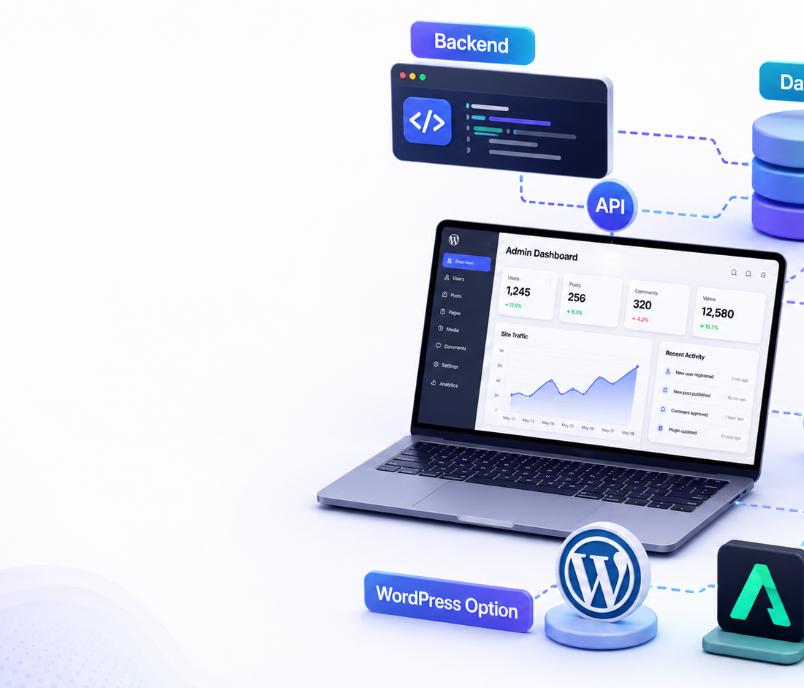
WEEK 4
Backend, Admin Dashboard
& Deployment
Participants transform their website from a beautiful front-end into a working platform: admin access, database, forms, content management, and publishing.
GOAL: A functional web solution
TOOLS: Antigravity or WordPress
OUTPUT: Live demo + admin flow
Week 4 • Backend, Admin & Deployment | 1

Slide 2
Week 4 Objective
From front-end prototype to a working web system
This week answers one question:
How will the website store data, manage content, and work for real users?
🔐
1. Admin access
🗄️
2. Data model
🧭
3. User actions
🚀
4. Deployment
Who can login? What can the admin add, edit, delete, or publish?
Products, posts, users, contact forms, bookings, or course data.
Contact, subscribe, register, buy, book, or request information.
Choose the easiest professional publishing path.
Participant mission
Select one business website from Week 3 and define the exact backend functions needed to make it useful.
Week 4 • Backend, Admin & Deployment | 2

Slide 3
Backend Map
What participants must connect behind the website
🌐
⚙️
🗄️
👤
Website UI
API / Logic
Database
Admin
✍️
Input
⚡
Processing
📊
Output
Forms, registration, orders, bookings, comments, uploaded media.
Validation, permissions, saving content, sending notifications.
Dashboard, confirmation emails, website updates, reports.
Simple rule: every button on the website must have a clear action, a destination, and a confirmation.
Week 4 • Backend, Admin & Deployment | 3

Slide 4
Two Build Options
Participants choose the path that matches their level and project
Option A
Option B
Google Antigravity
WordPress Solution
Best for: custom applications, dashboards, APIs, AI features, and full-stack learning.
Best for: professional websites, CMS, blogs, products, services, and fast client delivery.
✓ Define user roles
✓ Install theme and plugins
✓ Create database structure
✓ Create pages and menus
✓ Build APIs and admin pages
✓ Configure forms / shop / posts
✓ Test flows and deploy
✓ Train admin to update content
Decision point: custom system = Antigravity · fast CMS = WordPress
Week 4 • Backend, Admin & Deployment | 4

Slide 5
Week 4 Task Plan
Suggested participant schedule
Day 1
Day 2
Day 3
Day 4
Day 5
Backend needs
Admin dashboard
Database & forms
Deployment path
Testing & demo
List every website action and what data it needs.
Design admin pages: login, content, products, forms, media.
Create fields, connect forms, test saving and editing.
Choose Antigravity or WordPress and publish a working version.
Fix issues, prepare demo, explain user flow and admin flow.
End of week deliverable: one live working website + one admin/backend walkthrough.
Week 4 • Backend, Admin & Deployment | 5

Slide 6
Checklist Before Presentation
What each participant must show
🌐
Live website
🔐
Admin access
Homepage, menu, responsive design, working buttons.
Login screen and protected admin area.
✏️
Content control
📨
Form flow
Add/edit at least one item: post, product, service, event, or course.
Contact/register/order form saves data or sends notification.
💬
Client explanation
🚀
Next version
Explain why this technical solution fits the business.
List improvements for Week 5 or real launch.
Demo rule: show the result first, then explain the system behind it.
Week 4 • Backend, Admin & Deployment | 6

