Slide 1
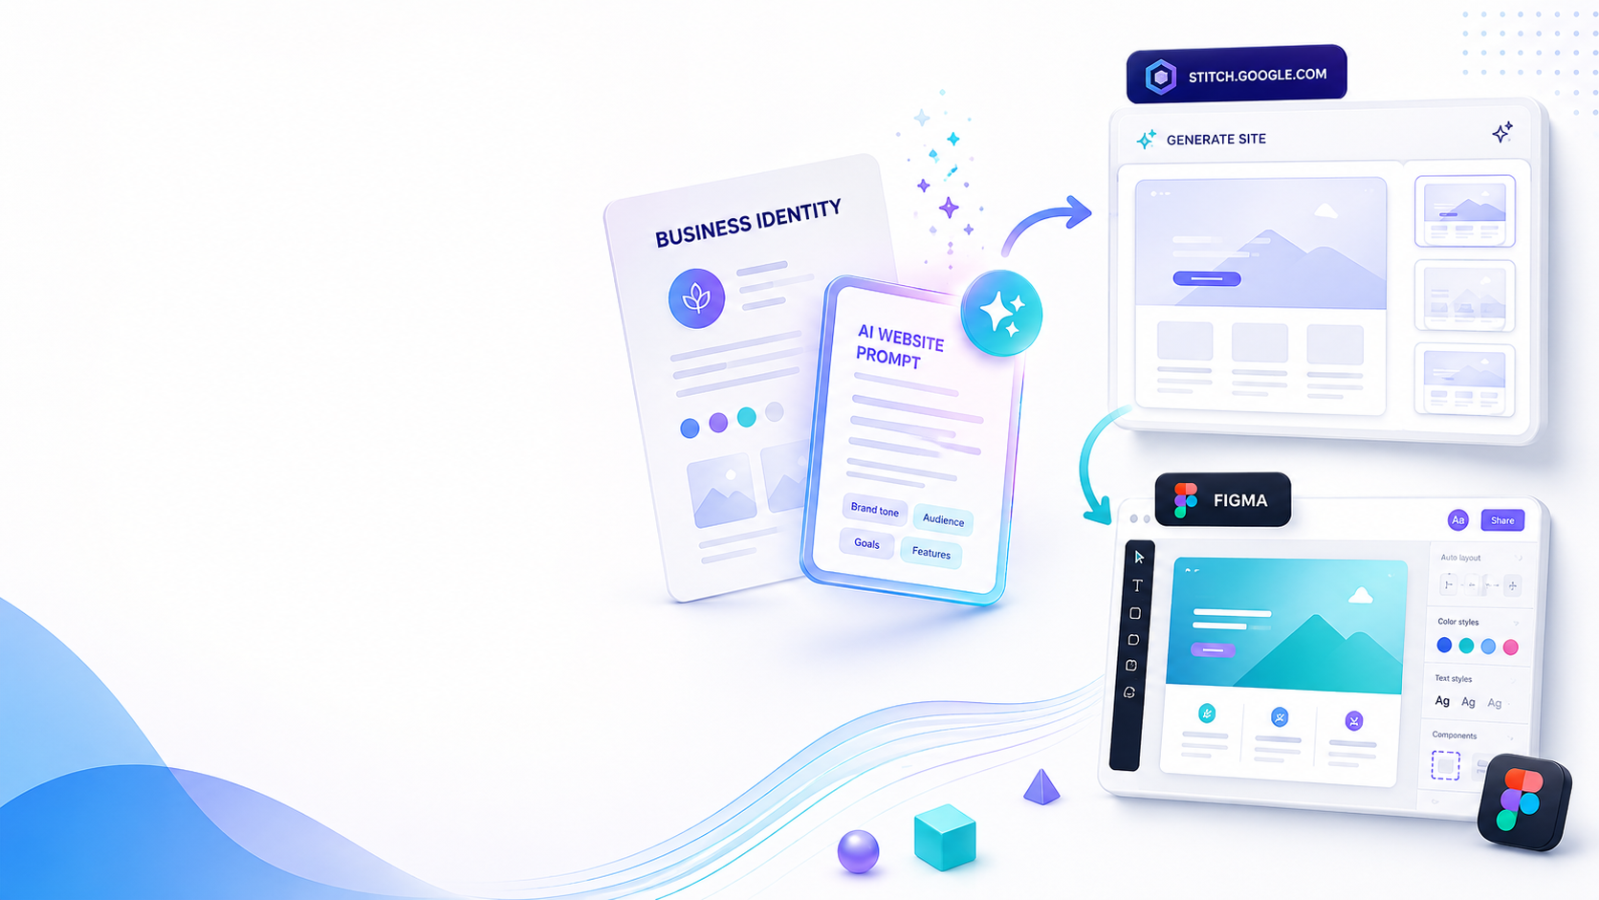
WEEK 2
From Identity to
AI Website Prototype
Participants transform the brand identity into a clear AI prompt, then generate the first website direction using Stitch and refine it in Figma.
Prompt Form
Stitch
Figma
Prototype
Goal
Output
Skill
Create the first website concept.
AI prompt + Figma prototype.
Thinking like a web strategist.
AI Marketing Team • Web Creation Program

Slide 2
Week 2 Roadmap
Week 2
Each participant follows the same workflow, but applies it to their own project.
📥
✍️
✨
🎨
🗣️
1. Collect
2. Prompt
3. Generate
4. Refine
5. Present
identity + goals
structured AI brief
Stitch website draft
Figma design system
prototype + feedback
Teacher focus: make students understand that AI gives better websites when the prompt contains brand, audience, pages, style, and clear business goals.
AI Marketing Team • Web Creation Program

Slide 3
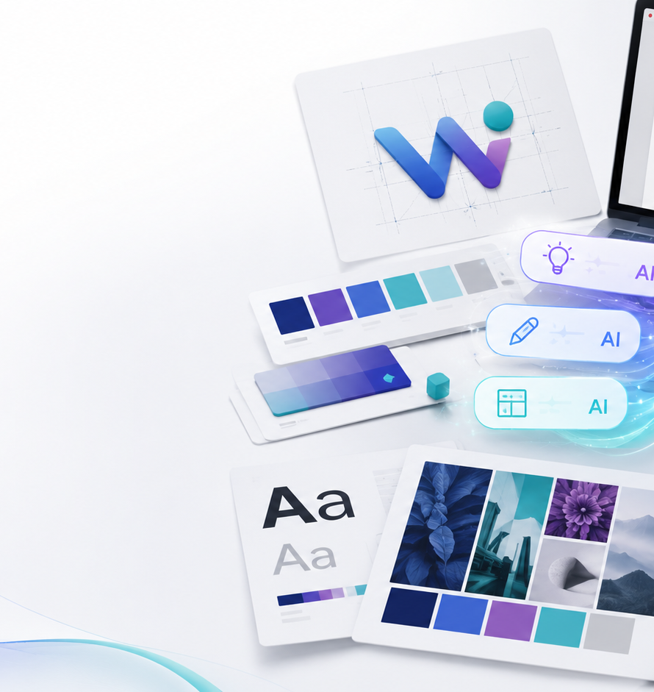
Part A — Web Logo & My Identity
Week 2
Participants prepare the minimum brand material before touching AI tools.
Logo direction
Identity statement
Choose the logo idea, symbol, colors, and what the logo should communicate.
Write: who we are, what we offer, why we are different, and who we serve.
Visual mood
Brand rules
Collect 5–10 examples: websites, colors, typography, photos, and styles.
Define tone: luxury, friendly, youth, professional, traditional, modern, etc.
Student output
One-page brand identity sheet ready to paste inside the AI prompt form.
AI Marketing Team • Web Creation Program

Slide 4
Part B — Prompt Form for AI
Week 2
The prompt form turns business thinking into a professional website brief.
Prompt Form Sections
Final AI Prompt Recipe
Business goal
What should the website achieve?
Role: act as a senior web strategist
Context: business identity + target audience
Target audience
Who is the website for?
Task: create a modern website concept
Pages needed
Home, About, Shop, Contact…
Structure: pages, sections, content, CTAs
Style direction
Colors, fonts, mood, references
Style: brand colors, fonts, mood, visuals
Features
Forms, dashboard, booking, shop…
Output: ready for Stitch + Figma refinement
Content
Texts, products, images, CTAs
Quality rule
Bad prompt = generic website. Strong prompt = website that respects identity and business goals.
AI Marketing Team • Web Creation Program

Slide 5
Part C — Stitch → Figma Workflow
Week 2
Participants move from AI-generated direction to editable design structure.
Paste prompt
Choose version
Export / recreate
Clean UI
1
Use the final prompt in Stitch to generate the first website direction.
2
Compare outputs and select the strongest structure.
3
Bring the design logic into Figma for refinement.
4
Fix spacing, colors, typography, components, and sections.
AI Marketing Team • Web Creation Program

Slide 6
Week 2 Final Deliverables
Week 2
By the end of the week, every participant submits a clear web direction.
1
Brand identity sheet
Logo direction, colors, fonts, tone, audience, offer
Evaluation Grid
2
AI website prompt
One strong prompt ready for Stitch / Google AI tools
✓
Clarity of identity
Stitch output
First generated website direction or screenshots
✓
Quality of prompt
3
✓
Website structure
4
Figma prototype
Clean homepage structure with basic style system
✓
Design consistency
Presentation notes
What was changed, why, and what needs improvement
✓
Ability to explain choices
5
Ready for Week 3: Frontend Build
AI Marketing Team • Web Creation Program

