Slide 1
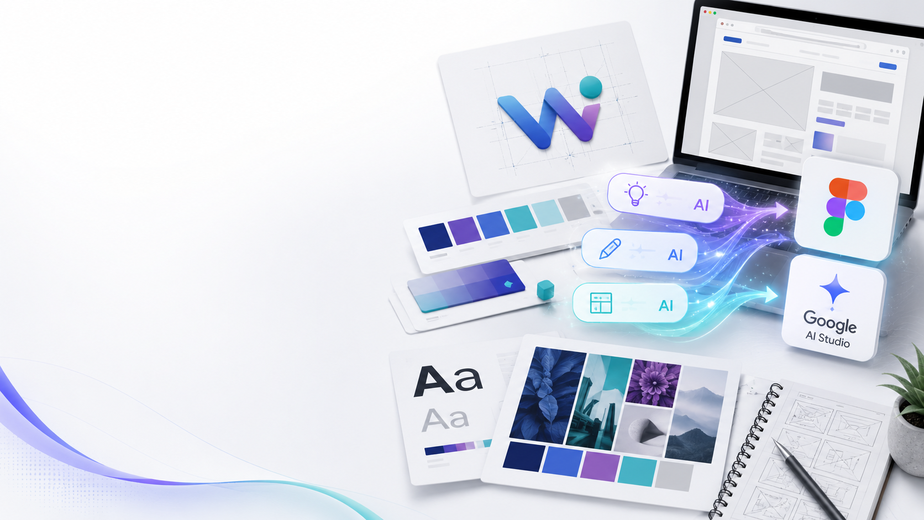
WEB CREATION WORKFLOW
Week 1: Web Logo & Brand Identity
A weekly task plan for participants to build a professional web identity before moving to AI prompts, Stitch, Figma, frontend, backend, and WordPress options.
Logo
Colors
Fonts
Voice
AI Marketing Team Database • Web Creation Training
Week 1

Slide 2
Full Web Path: From identity to launch
Each part becomes one week of participant tasks.
1
2
3
4
5
6
7
Logo & Identity
AI Prompt + Stitch
Figma
Frontend
Backend
WordPress Option
Launch Plan
Brand base
First concept
UI/UX prototype
Google AI Studio
Google AI Studio / Antigravity
CMS solution
Final delivery
Focus now: Week 1 creates the visual identity kit that every next week will use.
AI Marketing Team Database • Web Creation Training
Week 1

Slide 3
Week 1 Objectives
Participants turn a business idea into a clear visual identity.
1. Understand the business
2. Define the identity
3. Prepare web assets
Business name & story
Products / services
Target audience
Competitors reference
Logo direction
Color palette
Fonts and typography
Tone of voice
Logo files
Brand mini-guide
Hero message
Visual examples for AI
🏢
🎨
🧩
Result: every participant finishes Week 1 with a strong brand base ready for AI website generation.
AI Marketing Team Database • Web Creation Training
Week 1

Slide 4
Week 1 Task Plan
A simple 5-day rhythm for the first web part.
Day 1
Business brief
Fill the business profile: identity, products, prices, audience, story.
Day 2
Moodboard
Collect 10 visual references: logos, colors, fonts, competitors, web styles.
Day 3
Logo ideas
Generate 3 logo concepts, choose one direction, write the logic behind it.
Day 4
Identity kit
Finalize colors, fonts, tone of voice, button style, and homepage visual mood.
Day 5
Presentation
Present the identity kit and prepare files for Week 2 prompt generation.
AI Marketing Team Database • Web Creation Training
Week 1

Slide 5
Tool Workflow for Week 1
Where each participant creates and stores the brand identity.
🗂️
✨
🧵
🎛️
Database
AI Prompt
Stitch
Figma
Google Drive / Notebook
Gemini / ChatGPT
stitch.google.com
figma.com
Collect brand data and references
Generate logo direction and identity text
Try first web layout ideas
Organize UI colors, fonts, and components
Important: Week 1 is not coding yet. It is the identity foundation that guides every AI and design decision.
AI Marketing Team Database • Web Creation Training
Week 1

Slide 6
Participant Deliverables
What each participant must submit at the end of Week 1.
Identity mini-guide
Website content base
Asset folder
Logo selected direction
Primary and secondary colors
2 fonts: title + body
Tone of voice: 5 keywords
Hero title and subtitle
About text short version
Products / services list
Target audience statement
Logo file
Moodboard images
Competitor screenshots
AI prompt draft
Evaluation: clarity, consistency, creativity, and readiness for Week 2 AI prompt generation.
AI Marketing Team Database • Web Creation Training
Week 1

Slide 7
Handoff to Week 2
The identity becomes a strong prompt for web generation.
Week 1 output
Week 2 task
Final direction
Logo + colors + fonts + voice + content base
Create a complete AI website prompt and test first layout in Stitch
Choose the best concept before moving to Figma and Google AI Studio
Next slide deck: Week 2 — AI Prompt Form + Stitch.Google.com website concept.
AI Marketing Team Database • Web Creation Training
Week 1

