Slide 1
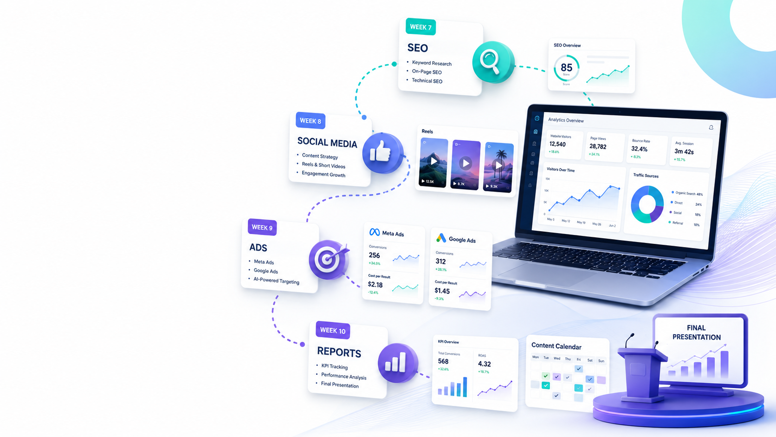
WEEK 7–10
Marketing System
for the Website
Participants transform the website into a real marketing engine: SEO, social media, ads, reports, and a final 90-day growth plan.
SEO
Social Media
Ads
Reports
Final outcome
✓
Website traffic plan
✓
Content calendar
✓
Ad campaign idea
✓
KPI dashboard
✓
7 / 30 / 90-day action plan
Web Creation Program • Week 7–10

Slide 2
Weeks 7–10 Roadmap
The website is finished; now participants learn how to attract, convert, and measure visitors.
7
8
9
10
SEO Foundation
Social Media
Ads & Campaigns
Reports & Final Plan
Keywords, pages, technical basics, blog ideas
Instagram plan, captions, hashtags, reels scripts
Offer, audience, budget, creatives and landing page
KPIs, weekly/monthly reports and 90-day plan
Principle: every marketing action must point back to the website and be measurable.
Web Creation Program • Week 7–10

Slide 3
Week 7 — SEO & Website Visibility
Participants make the website easier to find on Google and easier to understand for visitors.
01
1. Keyword Research
02
2. Website Pages
03
3. Content Ideas
Main keywords
Long-tail keywords
Local search terms
Competitor keyword ideas
Page title
Meta description
Headings H1 / H2
Clear page structure
Blog ideas
FAQ section
Service explanations
Educational posts
04
4. Technical Check
05
5. Local SEO
06
6. SEO Deliverable
Mobile view
Loading speed
Image names and alt text
Broken links
Location keywords
Google Business profile idea
Map and contact clarity
Testimonials
Keyword list
Optimized homepage
3 blog titles
SEO checklist
End of Week 7 output: SEO folder + keywords + optimized pages + content ideas.
Web Creation Program • Week 7–10

Slide 4
Week 8 — Social Media Content System
Participants create a content engine that supports the website and the brand.
✓
Define Instagram content pillars
✓
Write captions using the brand tone
✓
Create a hashtag bank
✓
Script 3 reels for awareness, trust, and conversion
✓
Prepare story ideas and call-to-action buttons
✓
Link every post to a website action
End of Week 8 output: 7-day social calendar + captions + hashtags + reels scripts.
Web Creation Program • Week 7–10

Slide 5
Week 8 Task Board
A practical weekly rhythm for content creation.
Mon
Tue
Wed
Thu
Fri
Sat
Sun
Brand Story
Problem
Proof
Education
Offer
Reel
Review
Who we are + why we exist
Pain point + simple solution
Before/after, testimonial or case
Tip, tutorial, checklist or FAQ
Promotion, launch or invitation
Short story with hook and CTA
Check comments, insights and ideas
The calendar must include: objective, platform, caption, visual idea, CTA, and link destination.
Web Creation Program • Week 7–10

Slide 6
Week 9 — Ads, Offers & Campaigns
Participants learn how to plan a simple campaign before spending money.
01
1. Campaign Goal
02
2. Audience
03
3. Offer
Website visits
Messages / leads
Registration
Product inquiry
Location
Age / interests
Pain points
Warm vs cold audience
Clear promise
Seasonal promotion
Deadline
Call to action
04
4. Creative
05
5. Budget
06
6. Tracking
Image or reel
Headline
Short copy
Landing page link
Daily budget
Campaign duration
Expected result
Cost per result
UTM idea
Landing page views
Messages
Conversions
End of Week 9 output: one Meta Ads plan + one Google Ads idea + ad copy + creative brief.
Web Creation Program • Week 7–10

Slide 7
Week 10 — Reports, KPIs & Final Growth Plan
Participants learn how to read results and propose next actions.
✓
Define the most important KPIs
✓
Create a weekly performance report
✓
Create a monthly improvement report
✓
Compare content, SEO, and ads results
✓
Build a 7-day, 30-day, and 90-day plan
✓
Present decisions based on data
End of Week 10 output: KPI dashboard + reports + final marketing roadmap.
Web Creation Program • Week 7–10

Slide 8
Final 7 / 30 / 90-Day Growth Plan
The participant leaves with a structured plan for continuing after the training.
7 Days
30 Days
90 Days
Fix and publish
Grow visibility
Scale performance
Finish checklist
Publish website
Create first 7 posts
Launch soft announcement
SEO improvements
Weekly blog or FAQ
Test one ad campaign
Collect testimonials
Optimize based on reports
Create campaign calendar
Improve landing pages
Build repeatable system
✓
↗
★
Web Creation Program • Week 7–10

Slide 9
Final Evaluation Criteria
Simple scoring grid for the participant project.
1. Website Quality
Design, mobile view, navigation, speed
/25
2. Marketing Logic
SEO, social plan, ads, CTA
/25
3. Data Thinking
KPIs, reports, improvement actions
/25
4. Professional Presentation
Clear story, demo, confidence, next steps
/25
Total: /100 • The best project is not only beautiful; it is clear, functional, and measurable.
Web Creation Program • Week 7–10

